Slide 1
IoT | smart buildings smart cities
George Minardos
CEO .build
@dotbuild_gtld

Slide 2
Overview
Notes:
Choose one of the three Overview slides that best represents your audience visually.

Slide 3
Overview
Notes:
Choose one of the three Overview slides that best represents your audience visually.

Slide 4
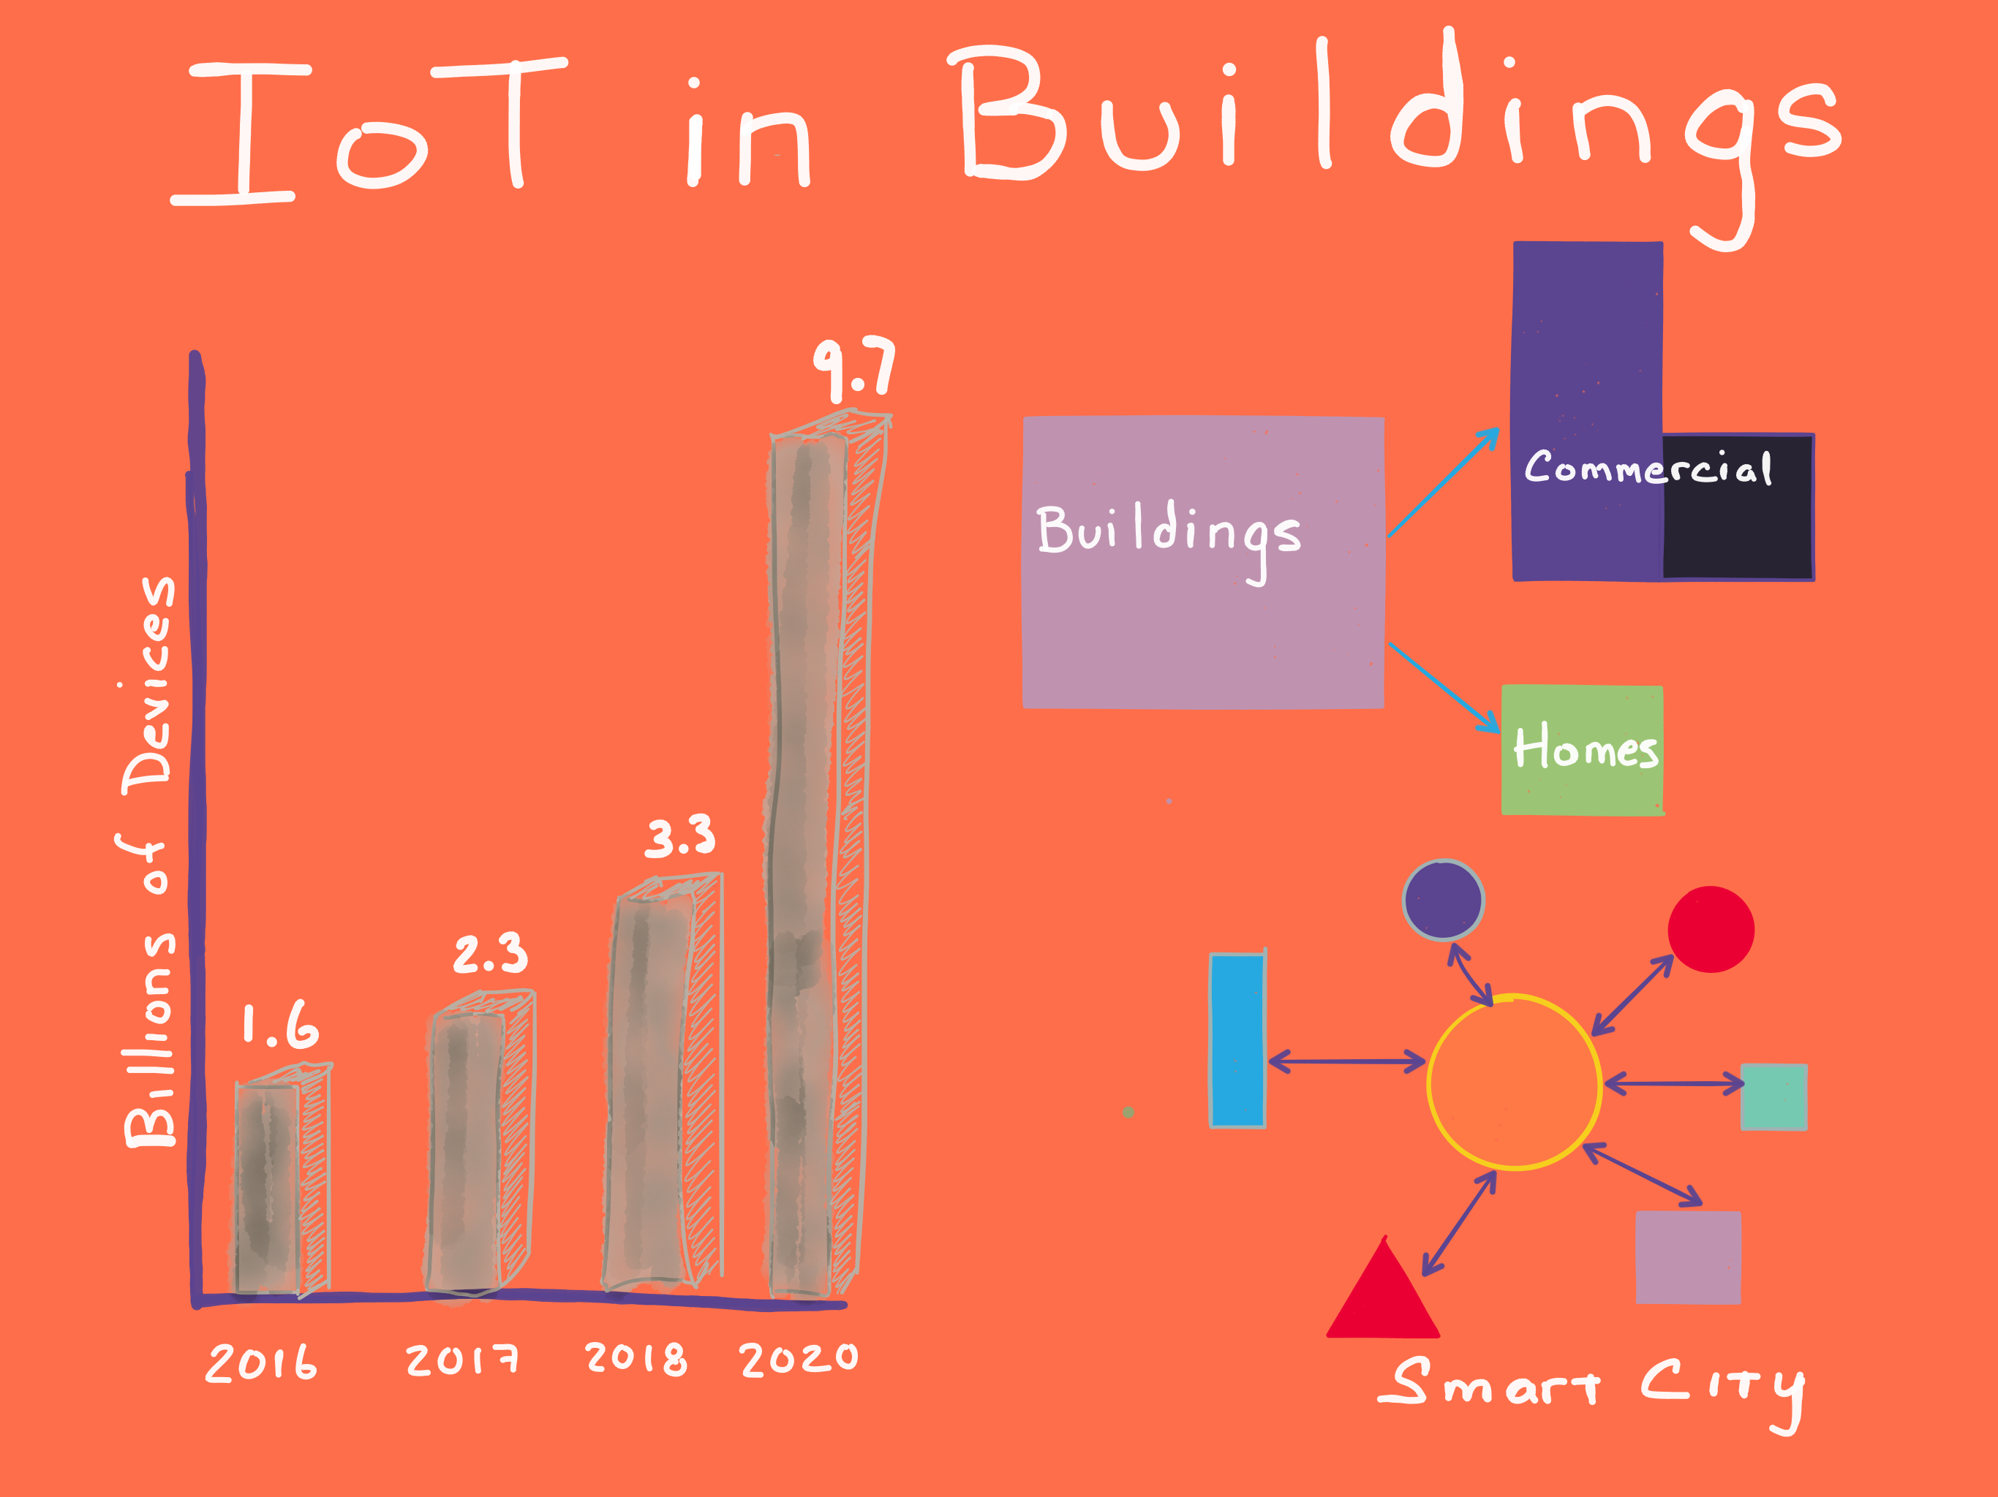

Slide 5
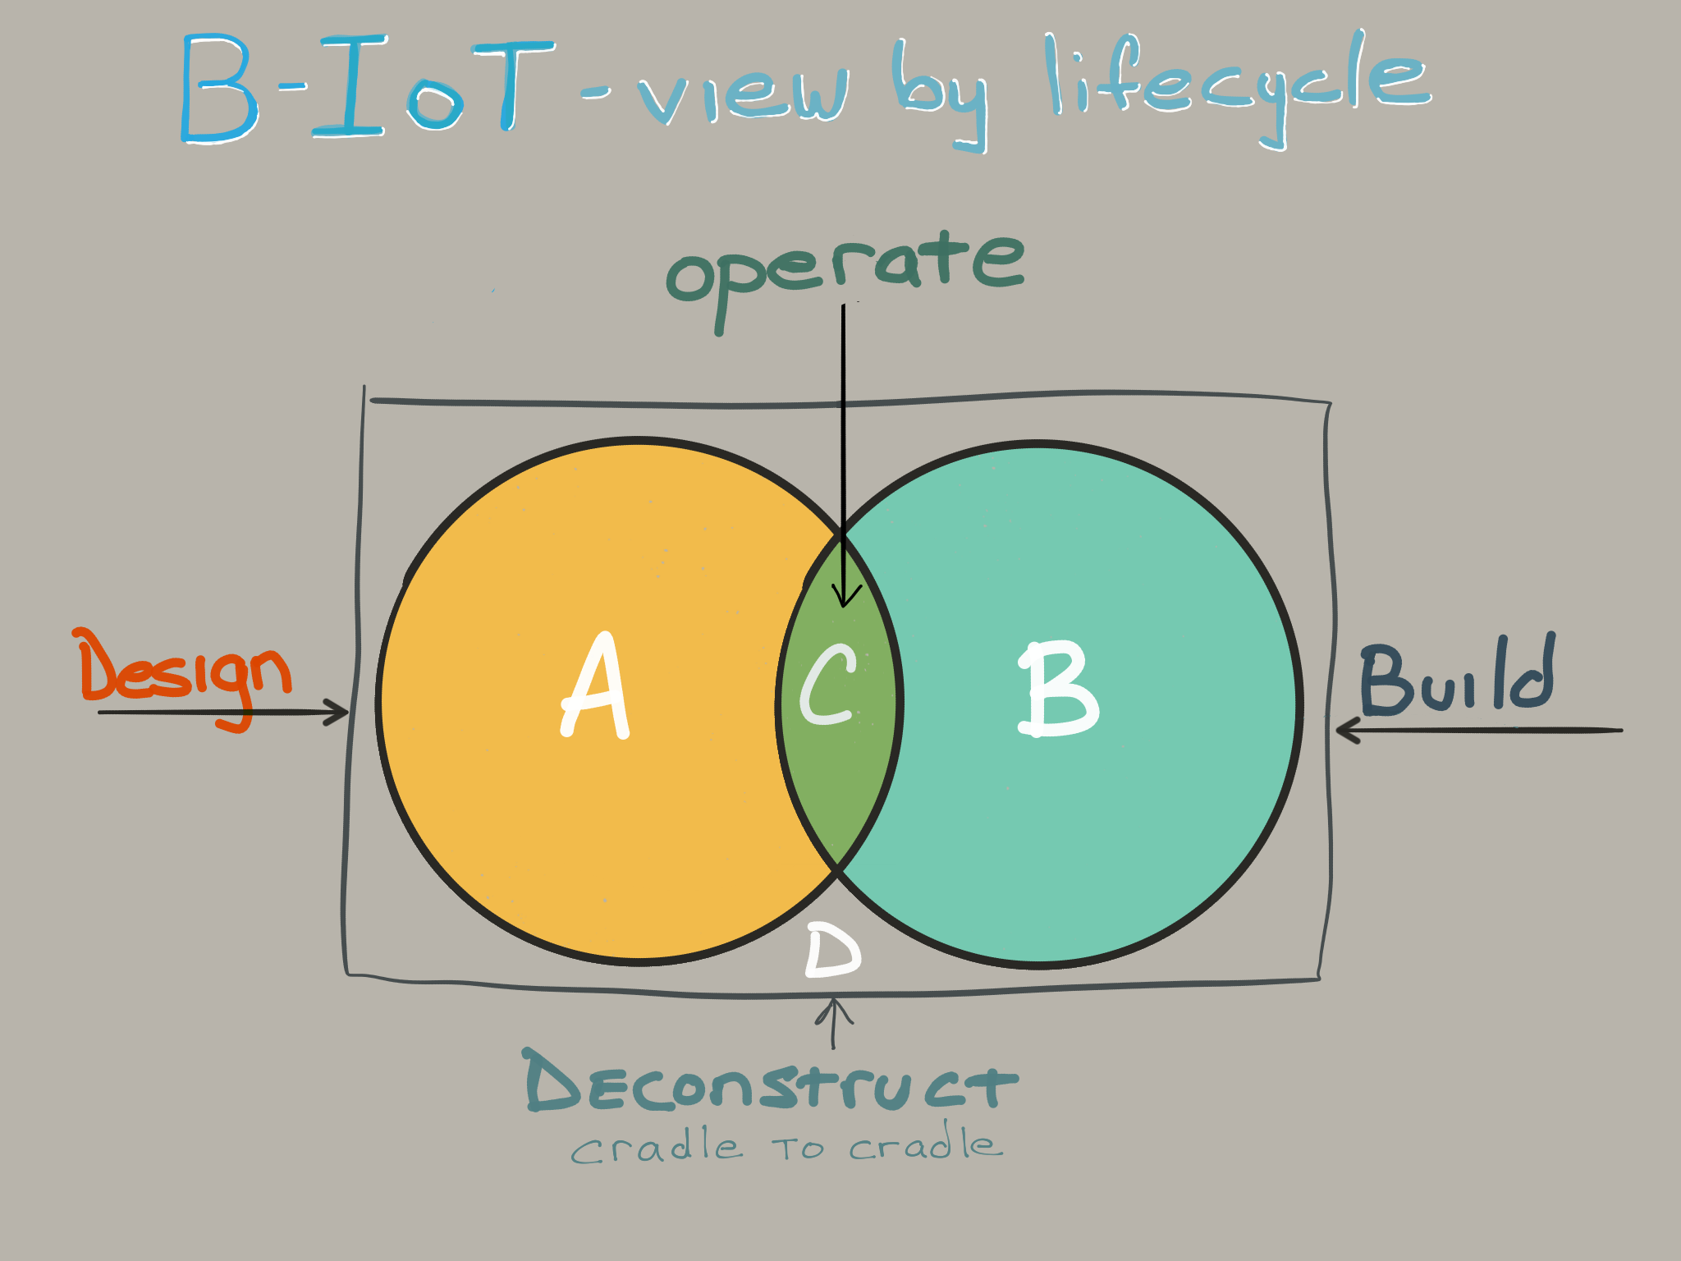
Notes:
Various environments and timeframes to consider when deploying IoT in the built world.

Slide 6
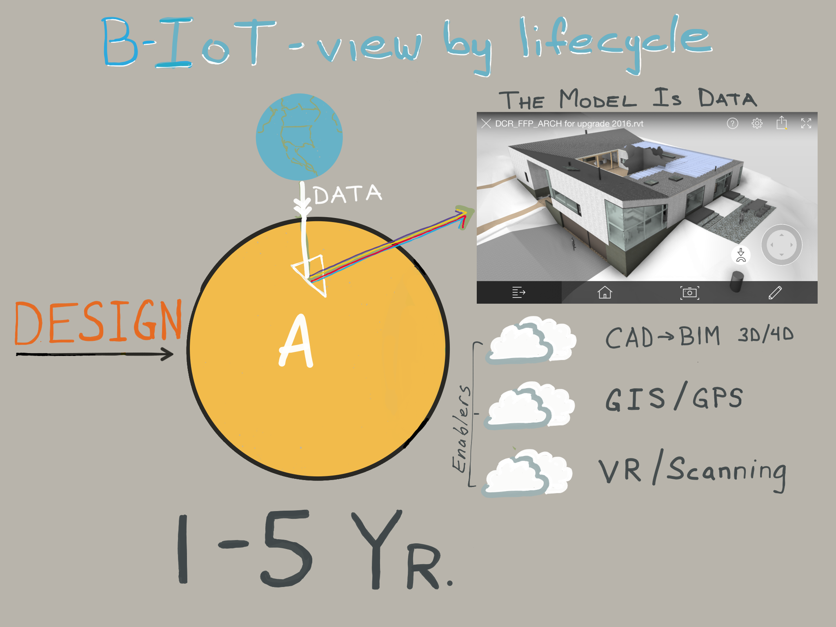

Slide 7
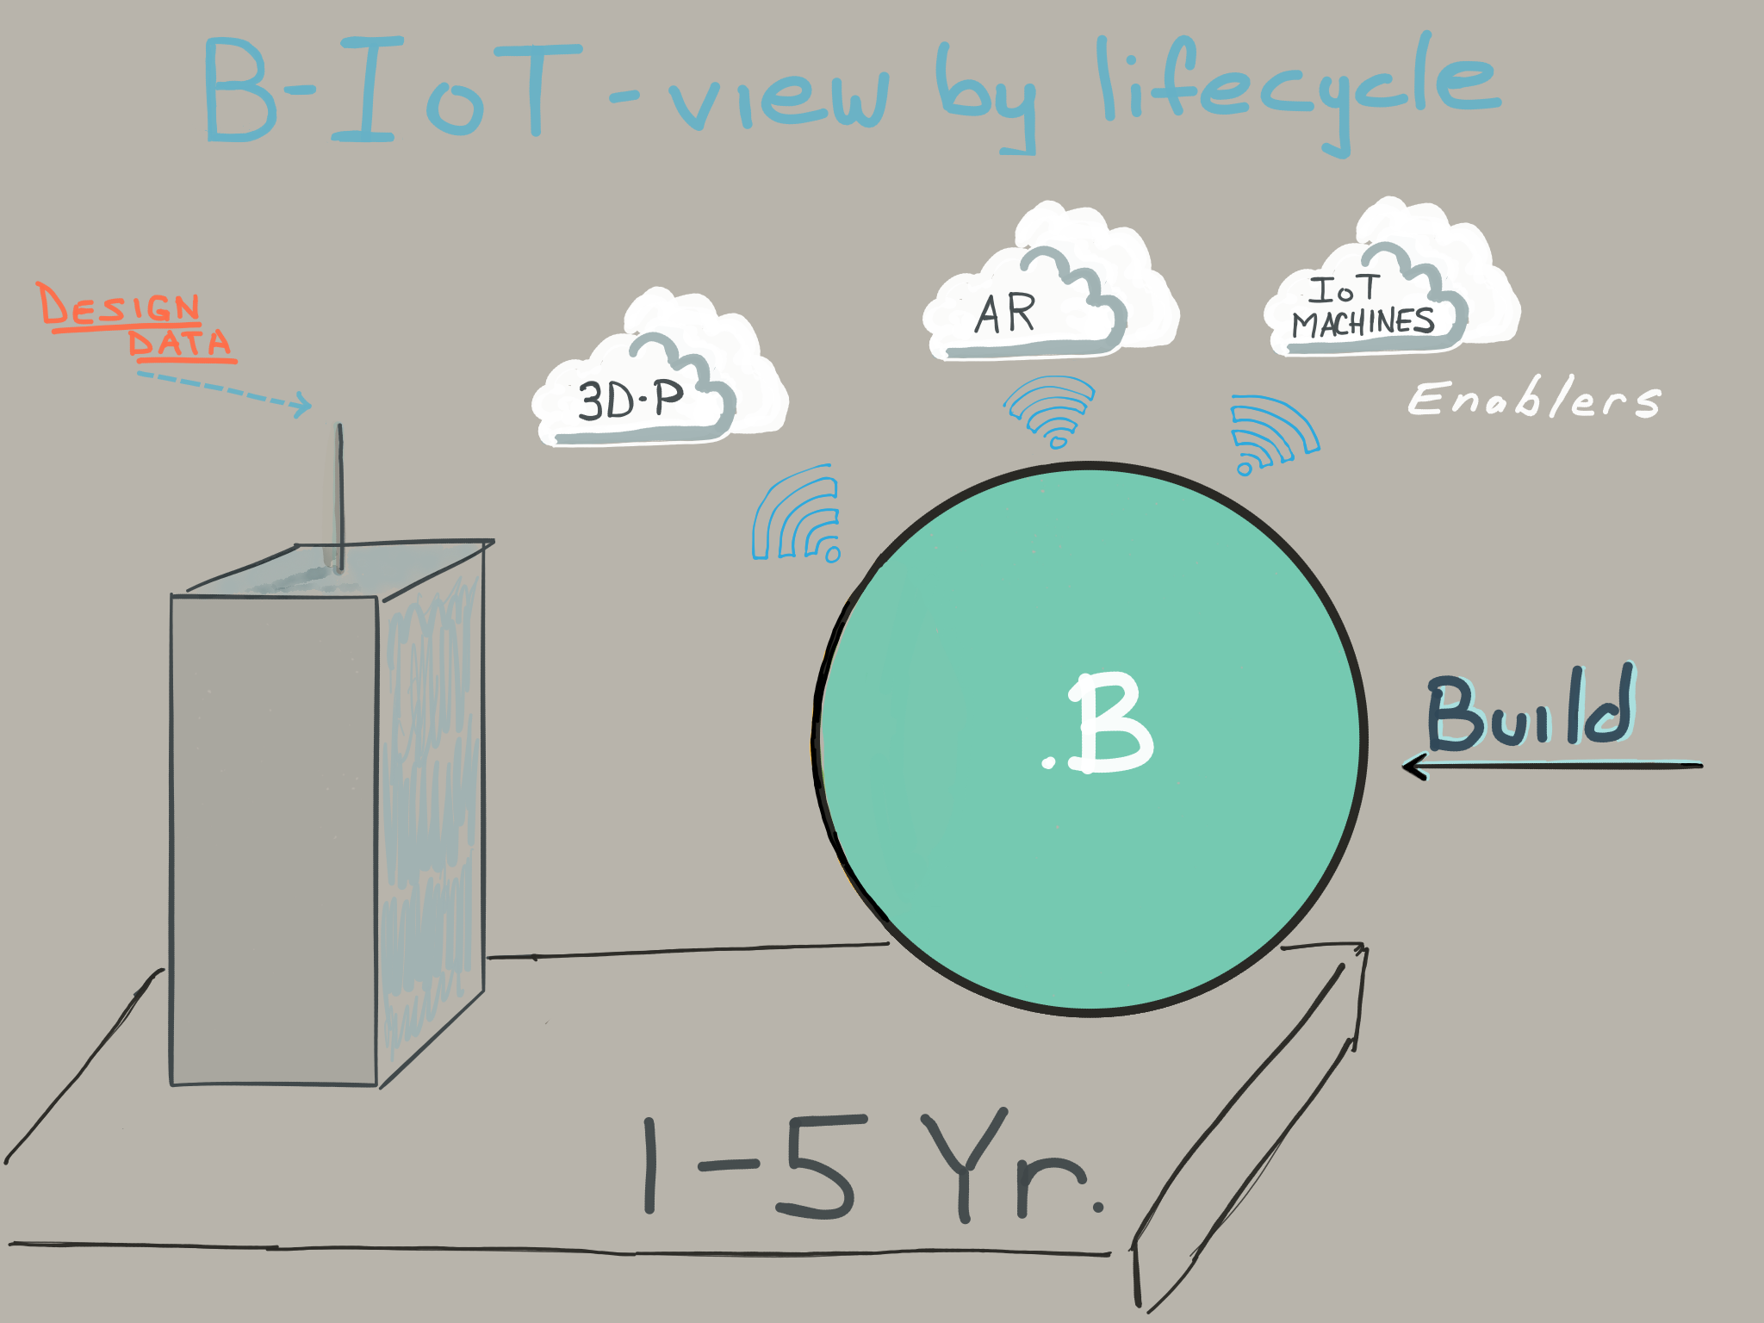
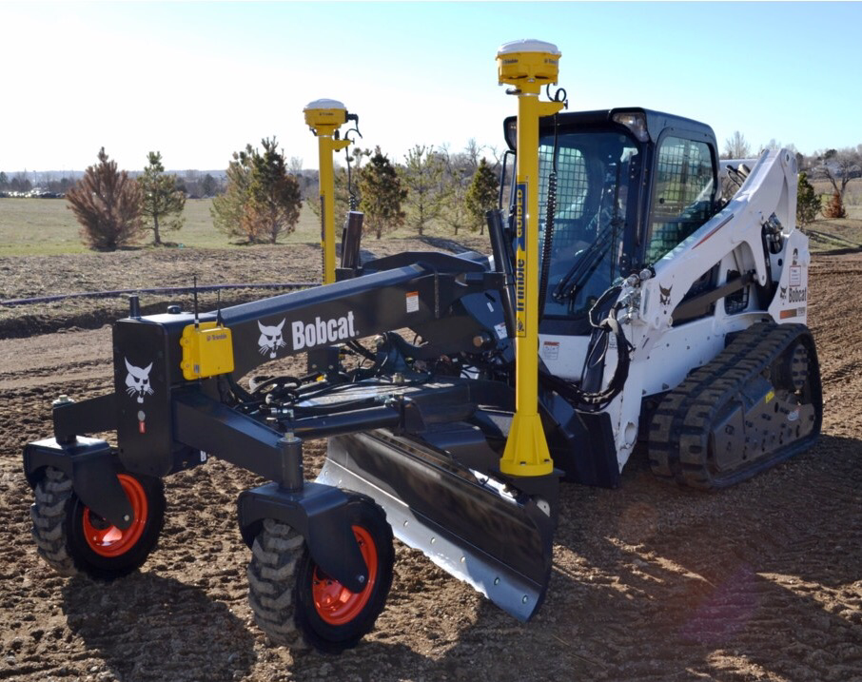
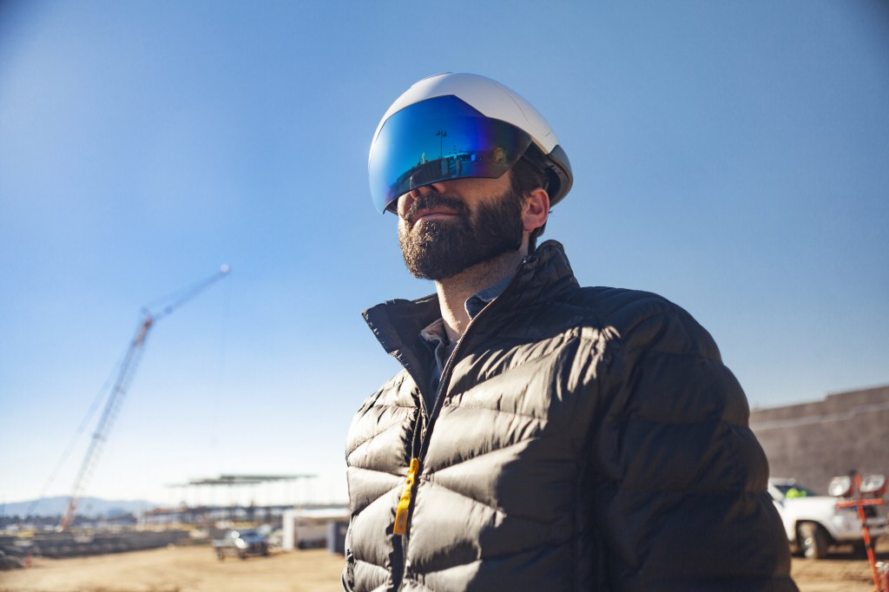
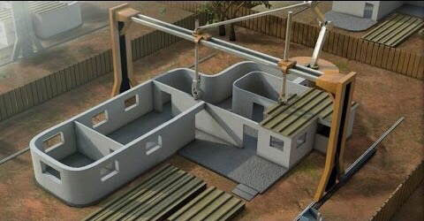

Slide 8
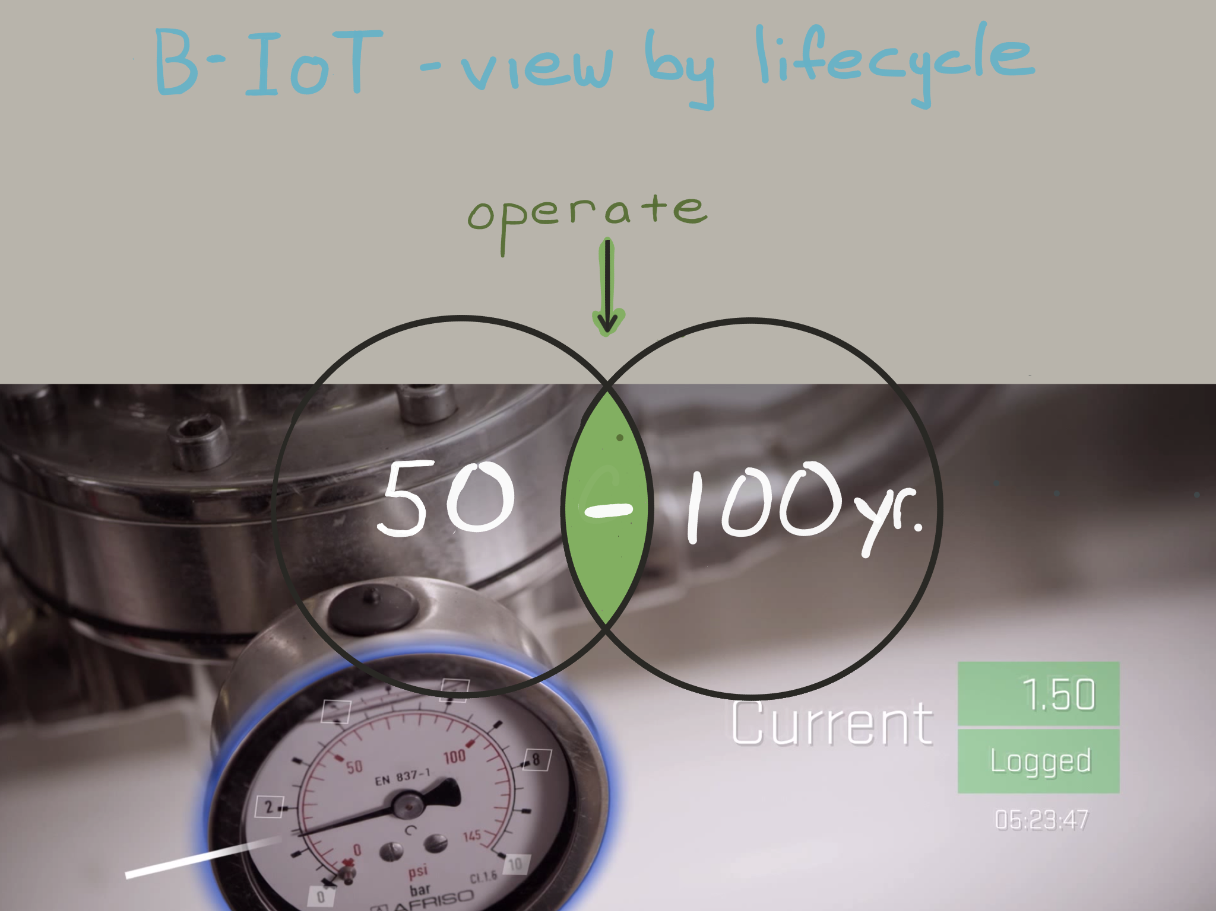

Slide 9
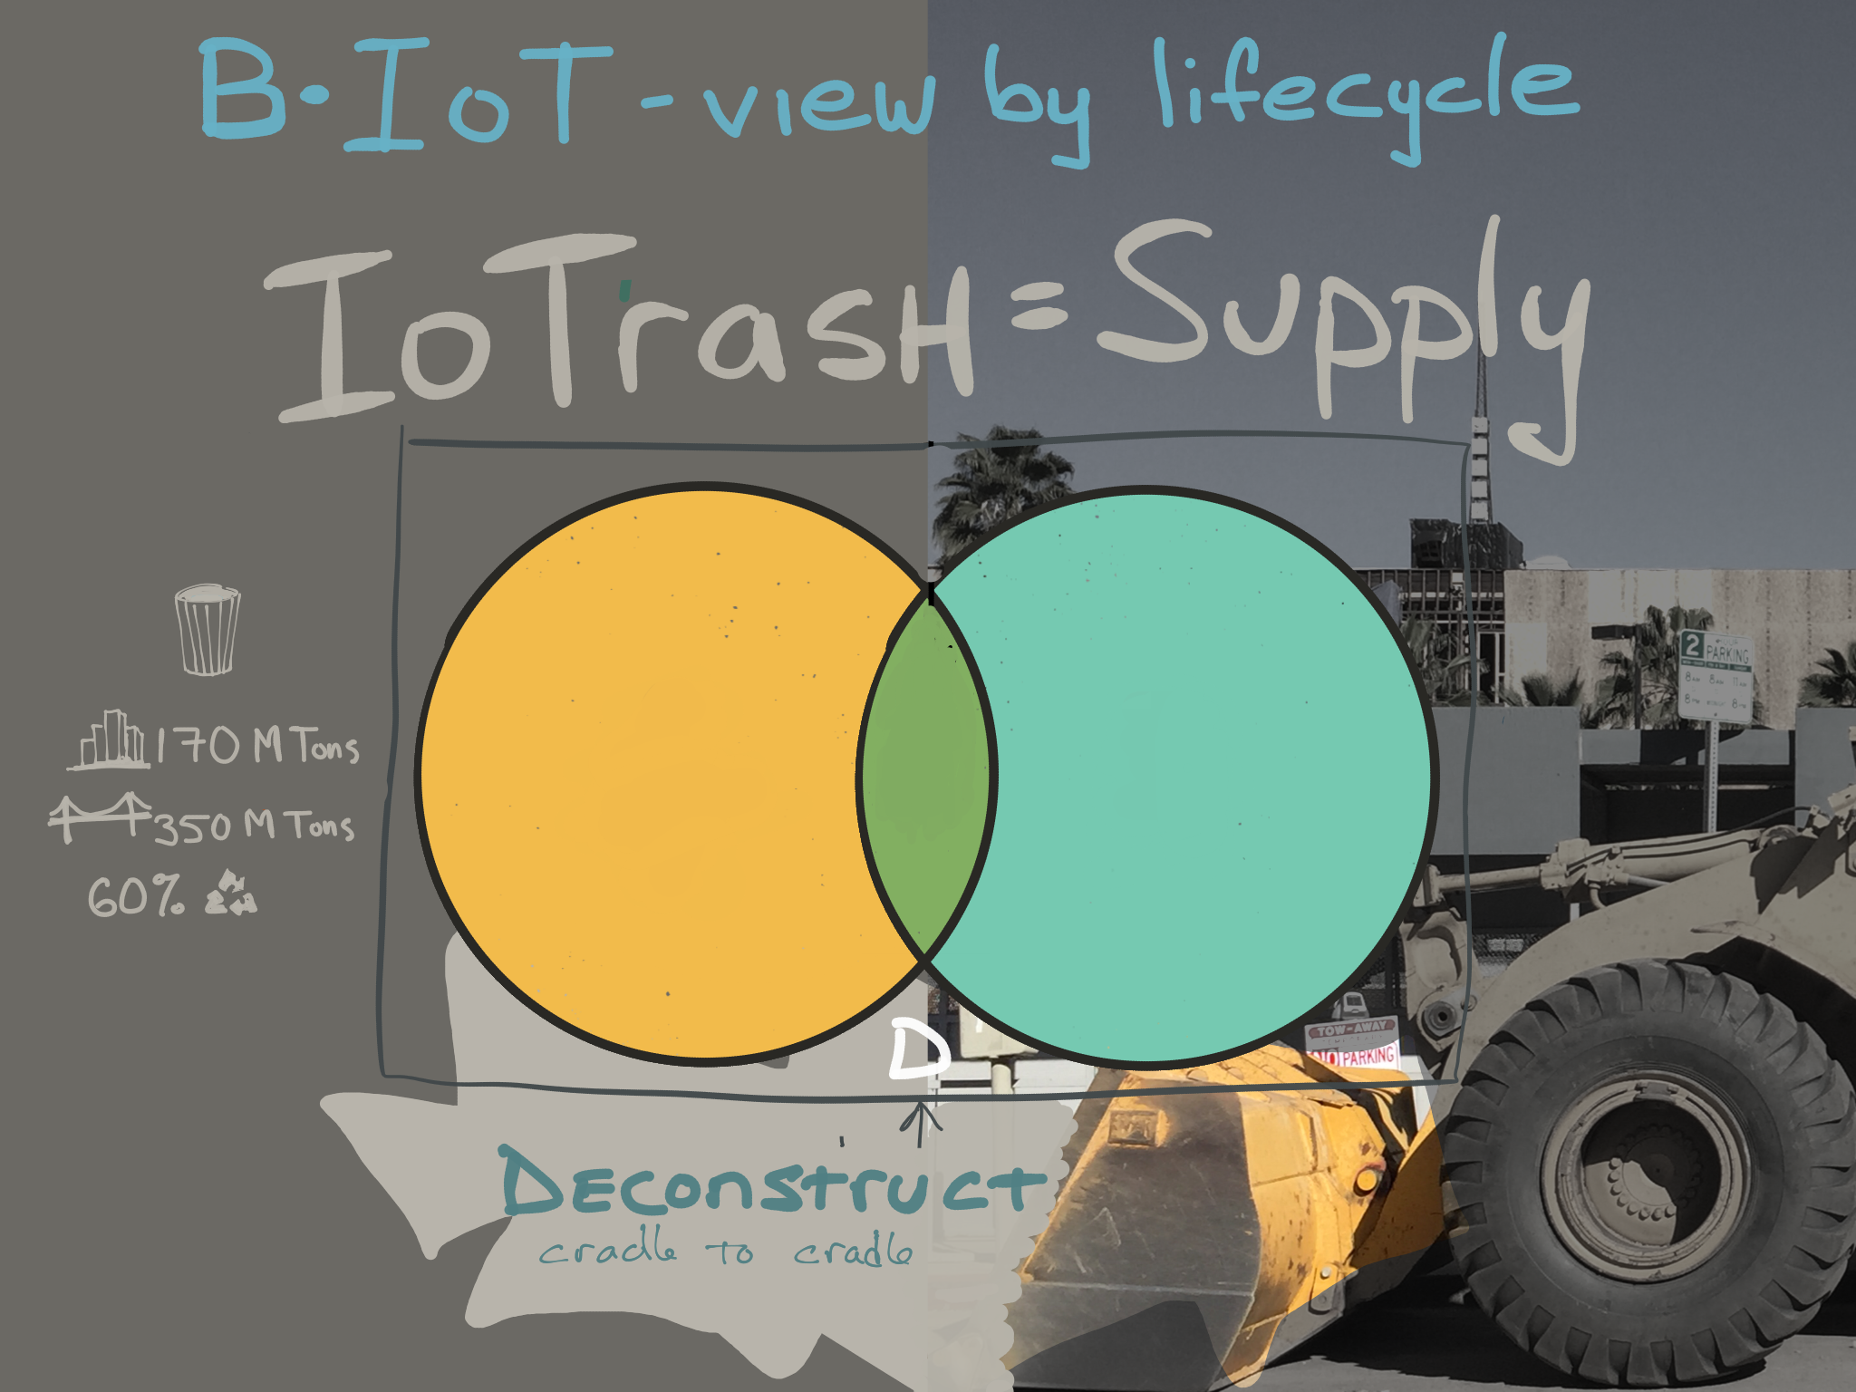

Slide 13
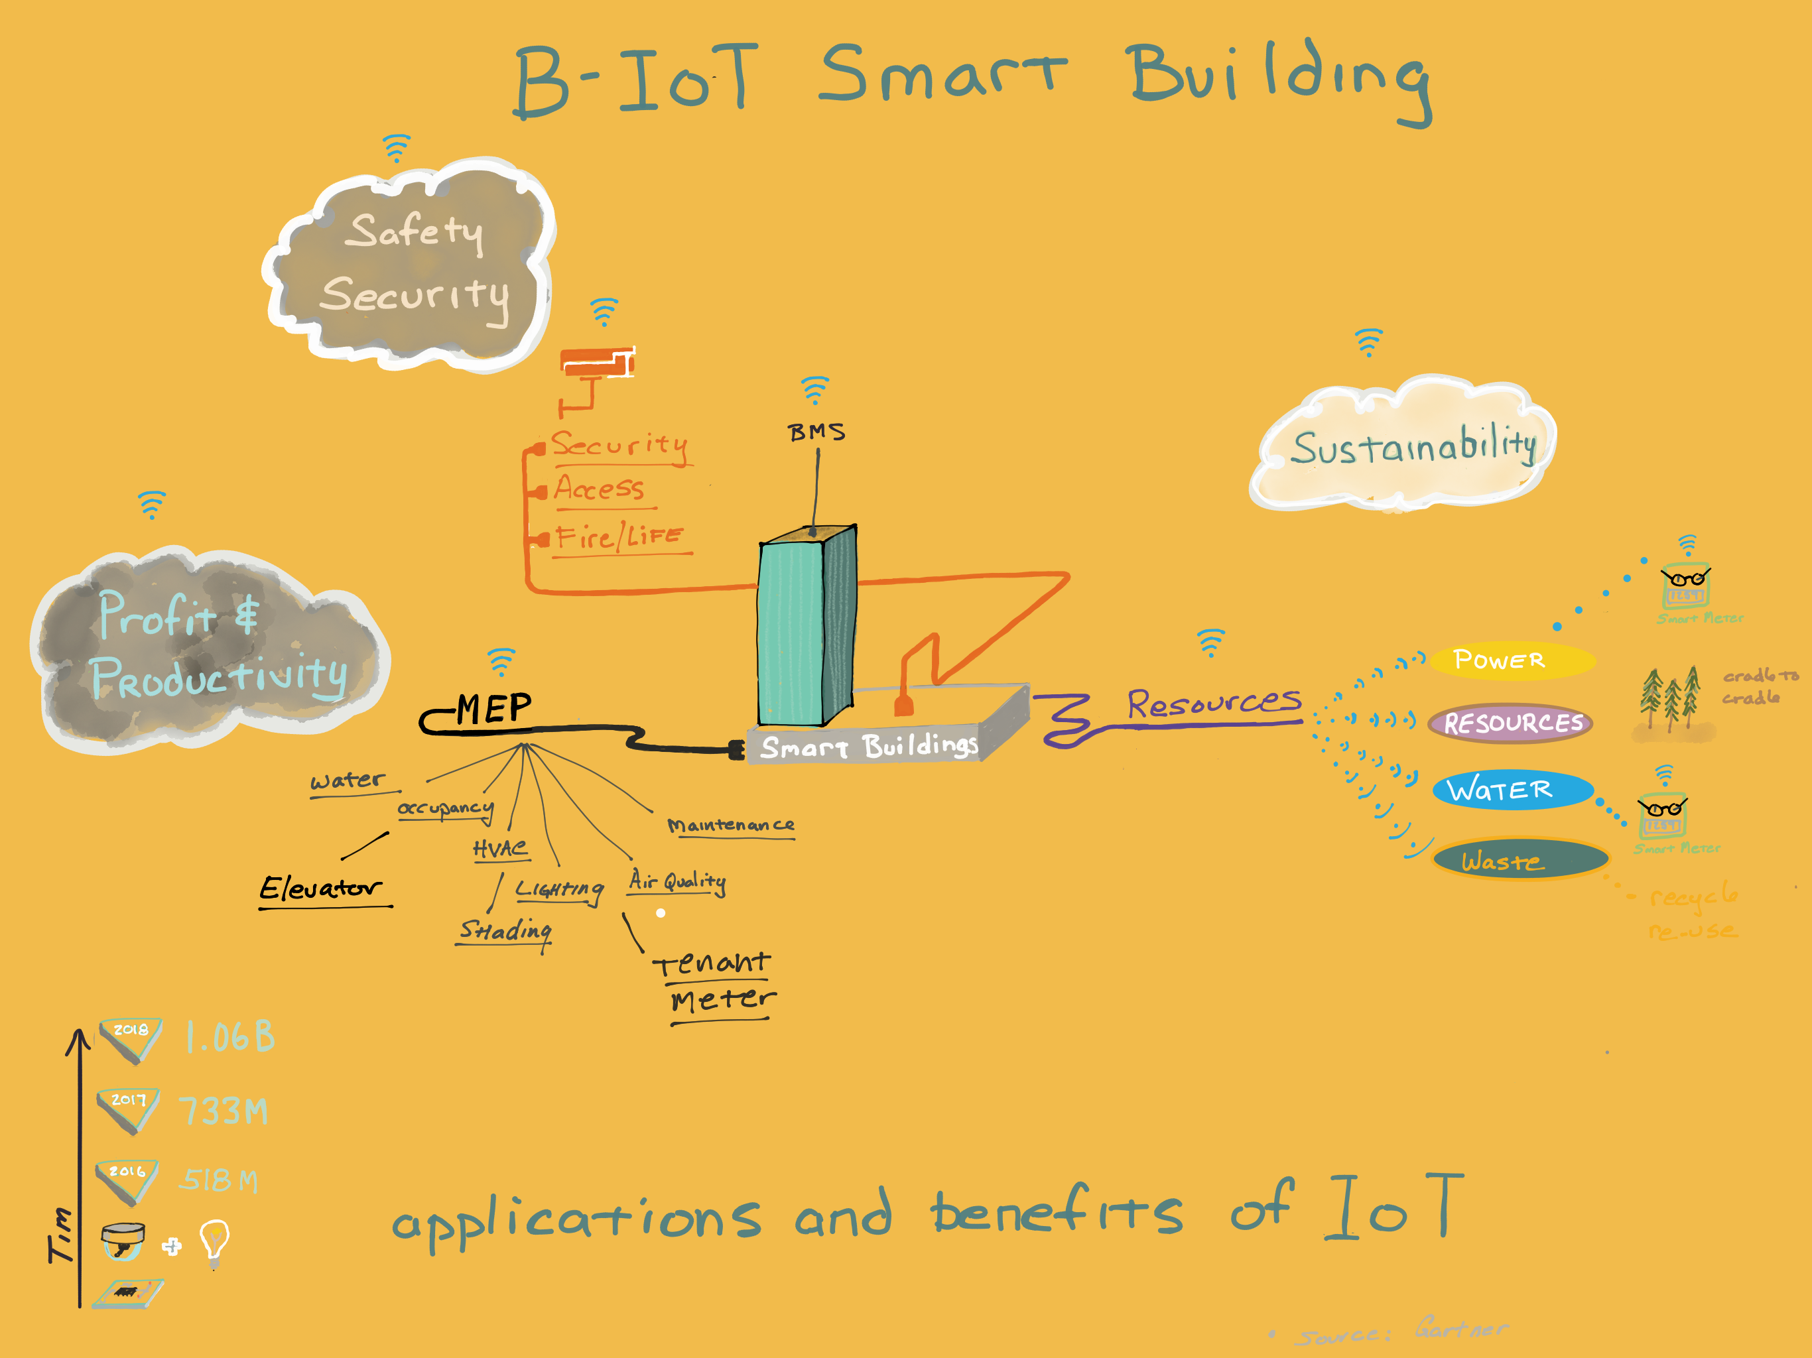

Slide 14
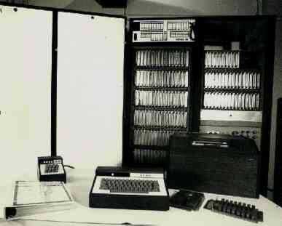
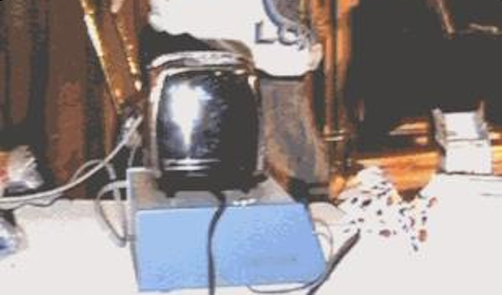
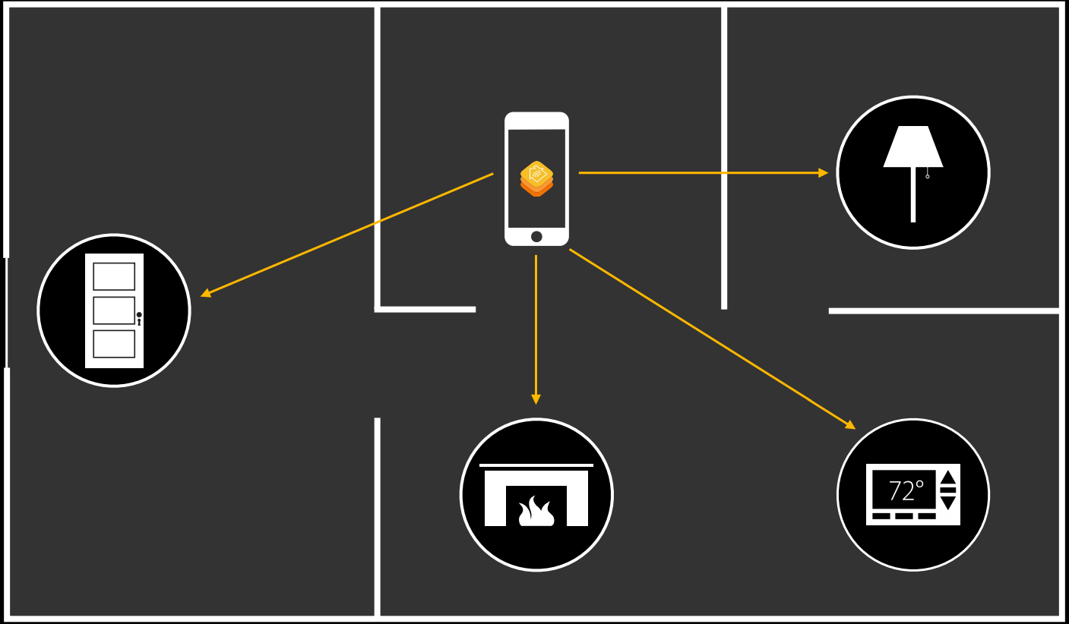

Slide 15
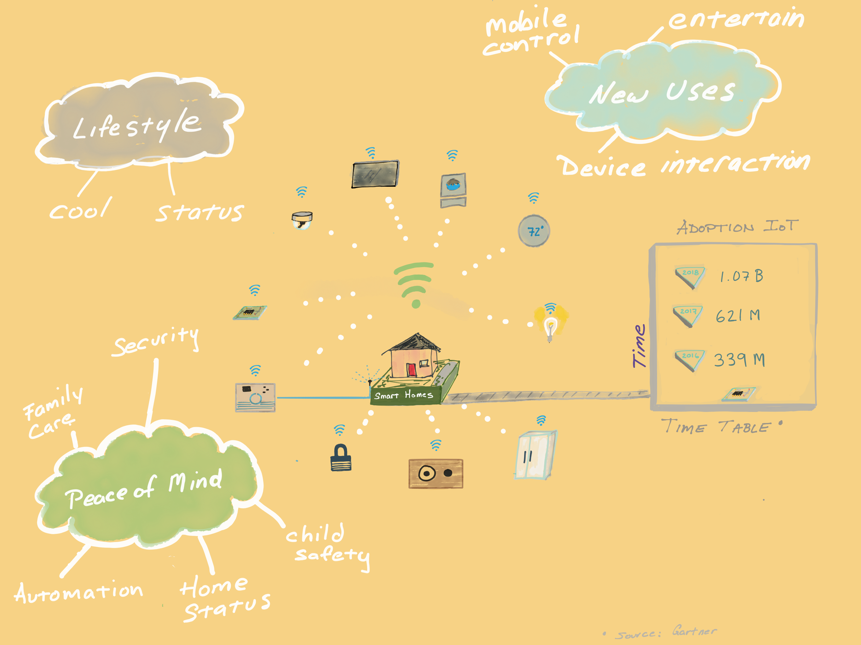
Notes:
Solar panel interface
State of industry: fragmented
User perspective

Slide 16
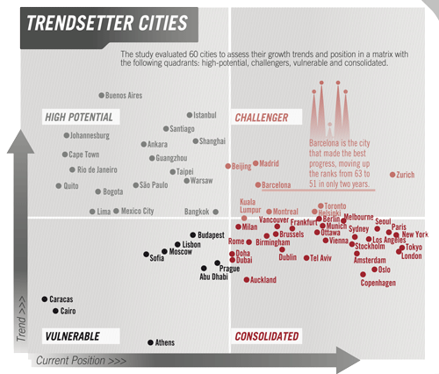

Slide 17
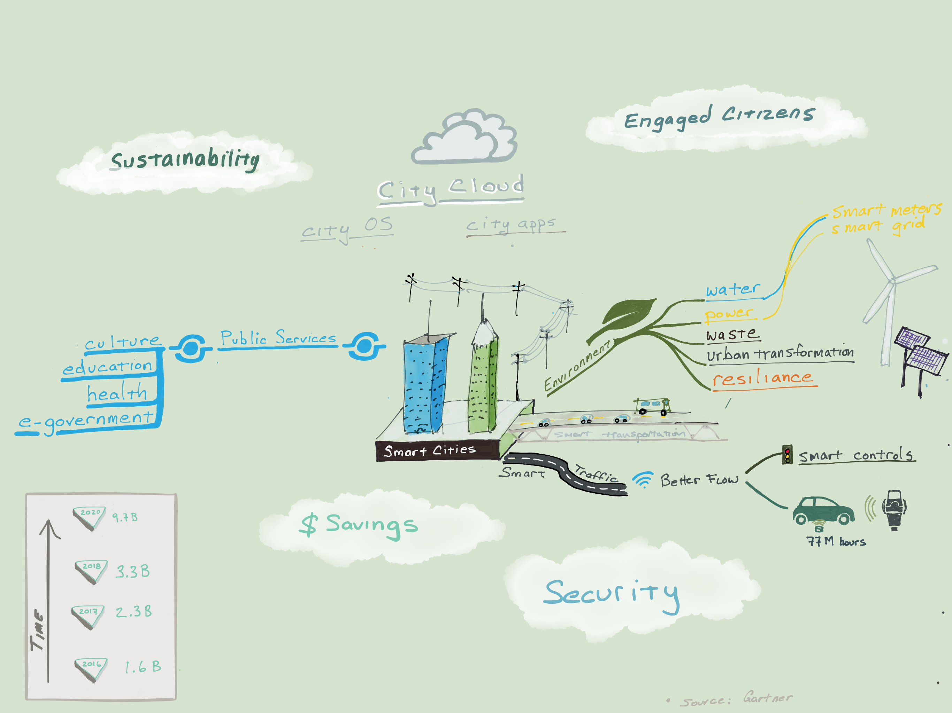

Slide 20
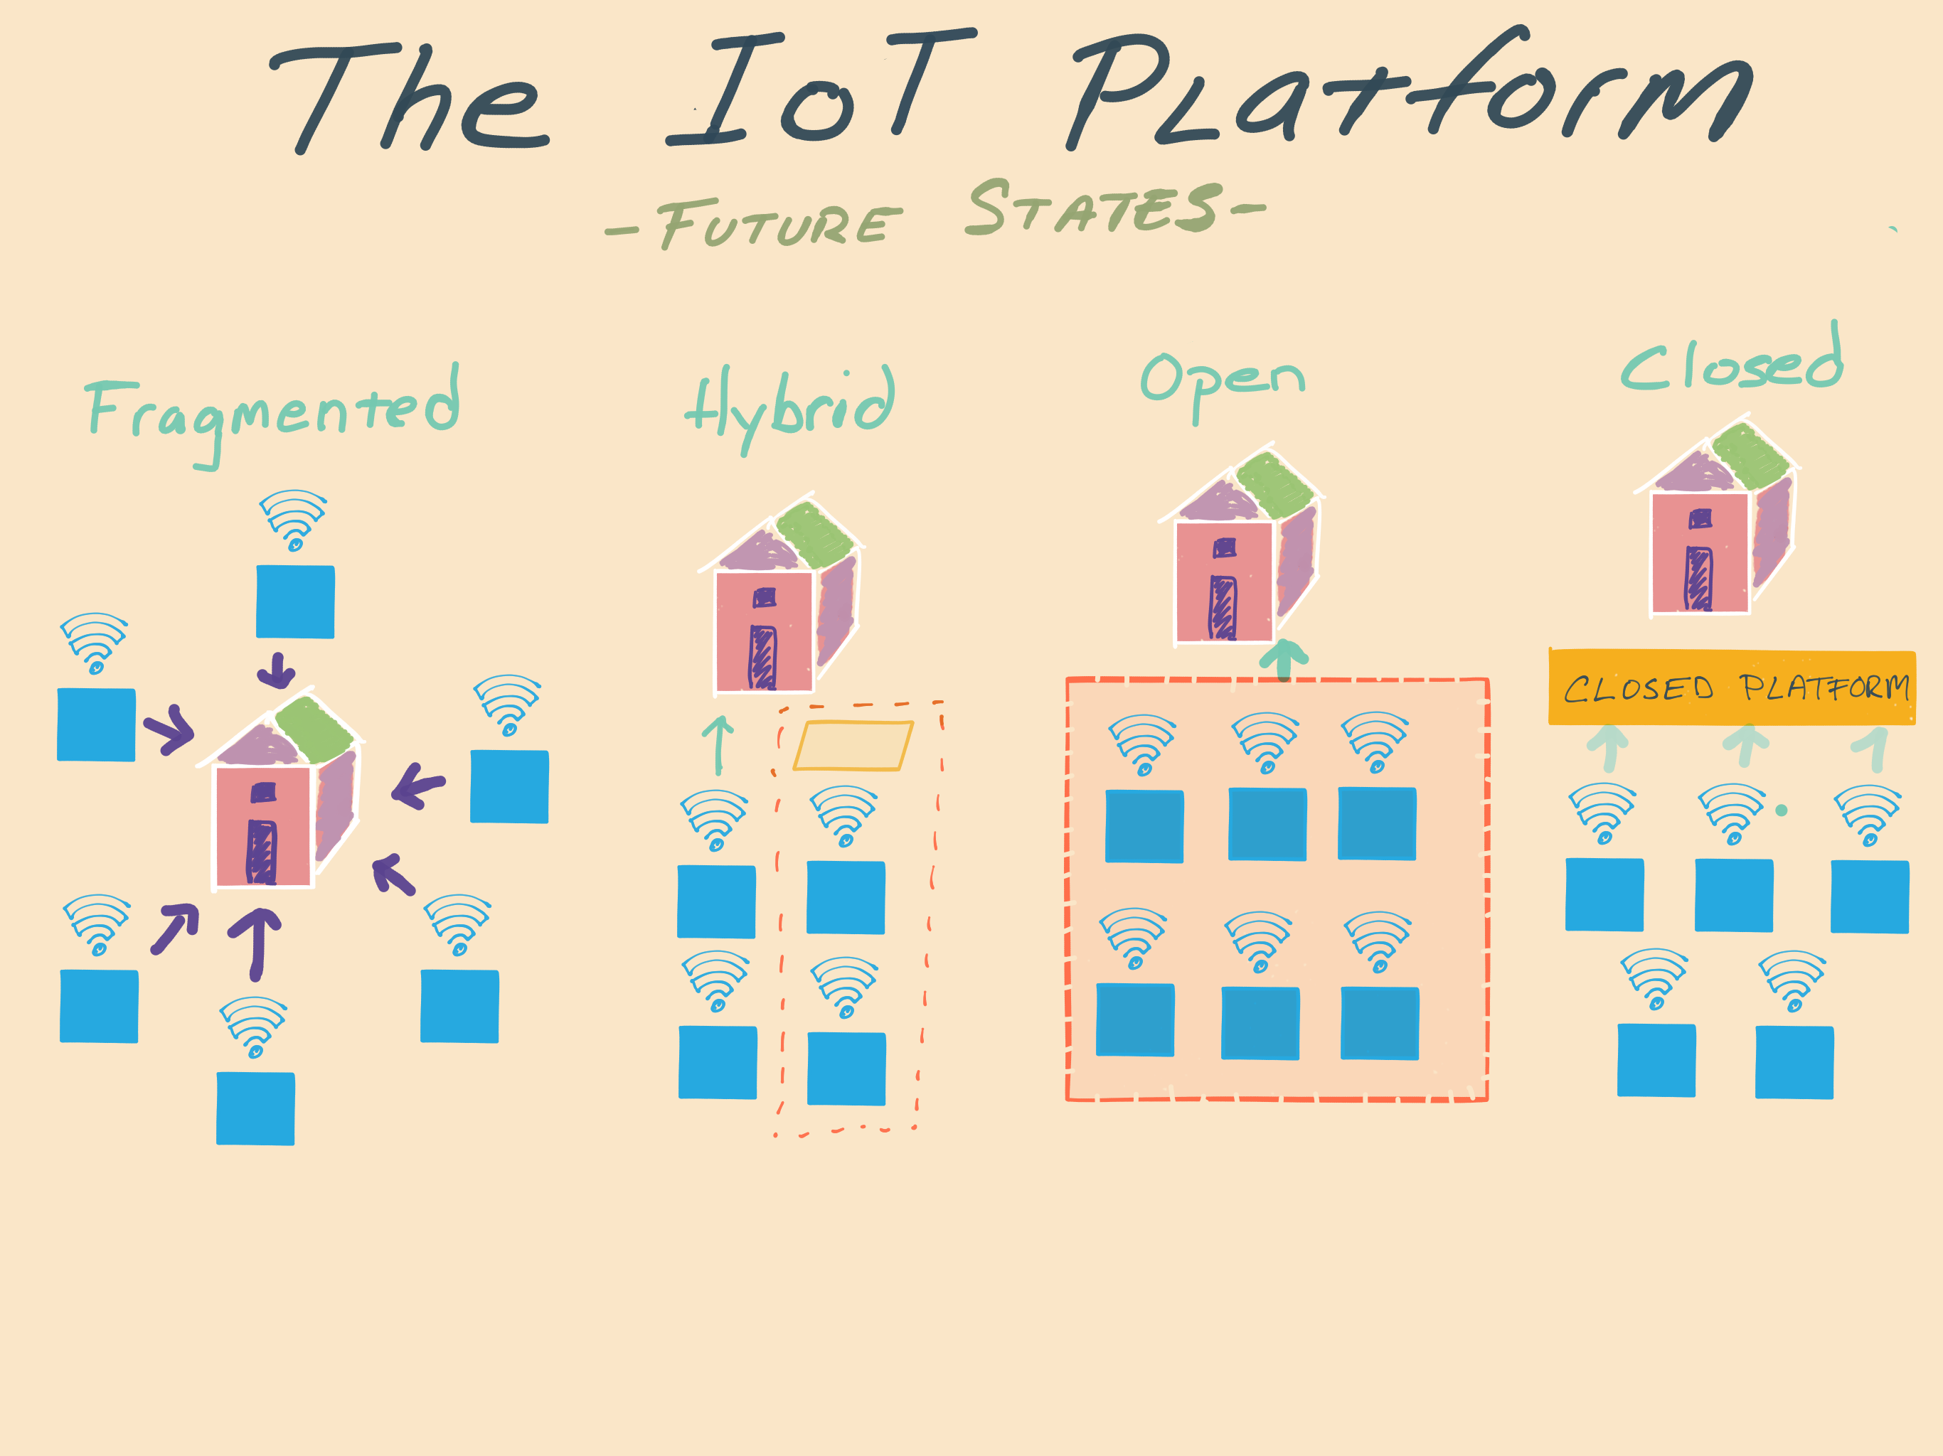

Slide 22
George@bmail.build

