Slide 1


IoT – Ascertaining what is Abnormal
to Detect Malicious Behavior
Merike Kaeo, CTO Farsight Security
merike@fsi.io
US San Francisco Bay Area Chapter

Slide 2
Goals For Today
What Is The New Normal?
Don’t Have Security As Afterthought
The Role DNS plays
Observable Behavior
Determining What Is Abnormal
How We Can Continue To Evolve
US San Francisco Bay Area Chapter

Slide 3
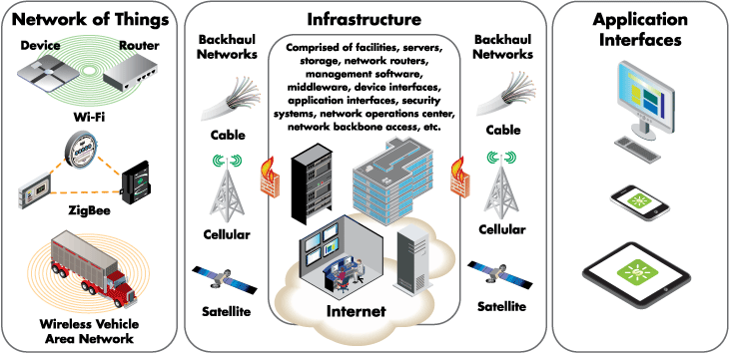
IoT Architecture
Source: digi.com
US San Francisco Bay Area Chapter

Slide 4
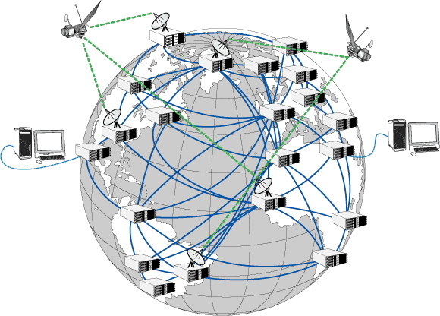
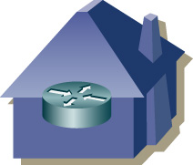

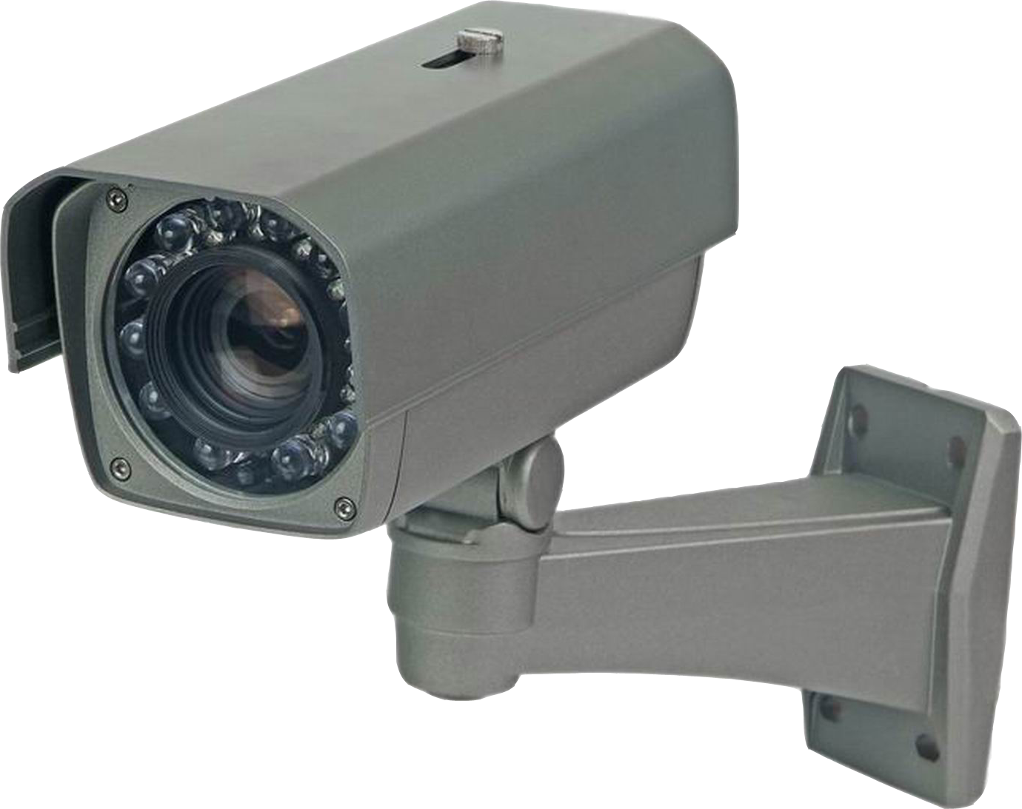


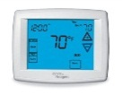

The New Normal
Adhoc Mesh Networks
Prevalent use of Tunneled Protocols
“There’s an App for That”
US San Francisco Bay Area Chapter

Slide 5
Fundamental Security Principles
Authentication
  Who (or What) are you?
Authorization
  What are you allowed to access or do?
Integrity
  Has data been altered?
Confidentiality
  Can only authorized eyeballs see data?
Availability
  Do I have access to data I need?
US San Francisco Bay Area Chapter

Slide 6

Fundamental Privacy Principles
Concern for how data is:
  Collected
  Analyzed
  Used
  Protected
Potential for increased surveillance and tracking
How is privacy changing in the world of
social media and information gluttony?
US San Francisco Bay Area Chapter

Slide 7
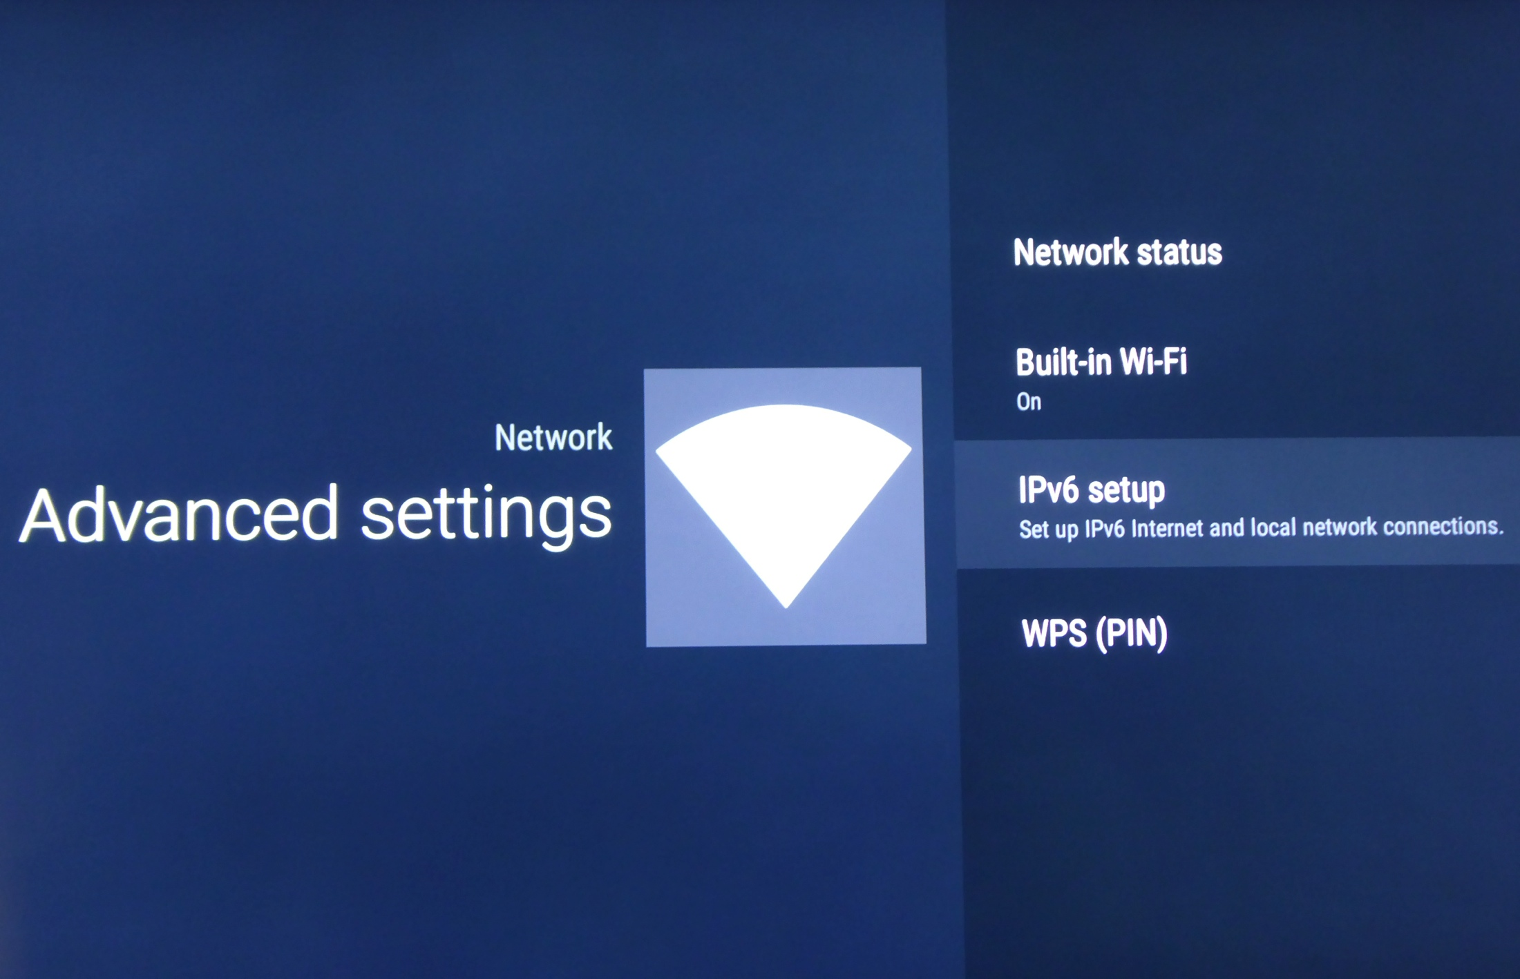
My Television Uses IPv6 (Really!!)
US San Francisco Bay Area Chapter

Slide 8
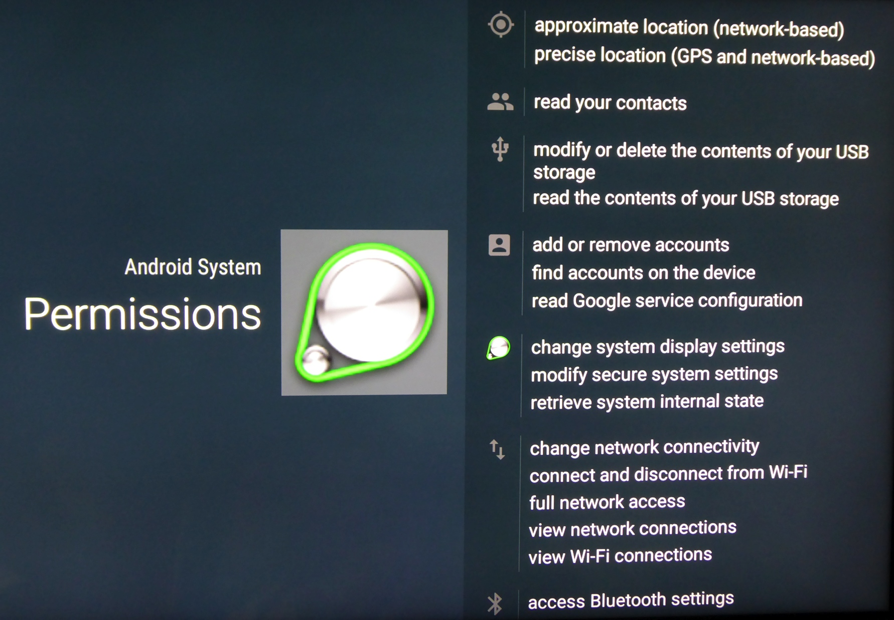
Television Default Permissions
US San Francisco Bay Area Chapter

Slide 9
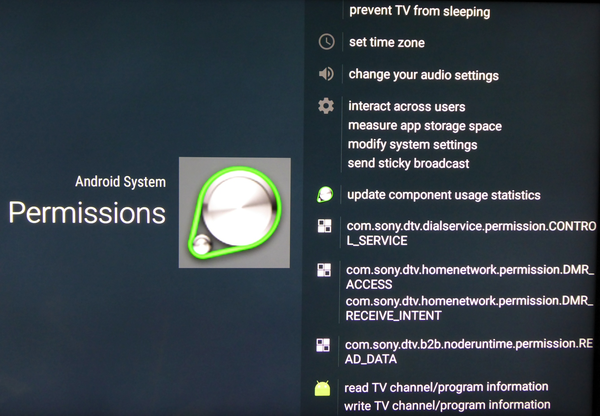
Television Default Permissions (2)
US San Francisco Bay Area Chapter

Slide 10
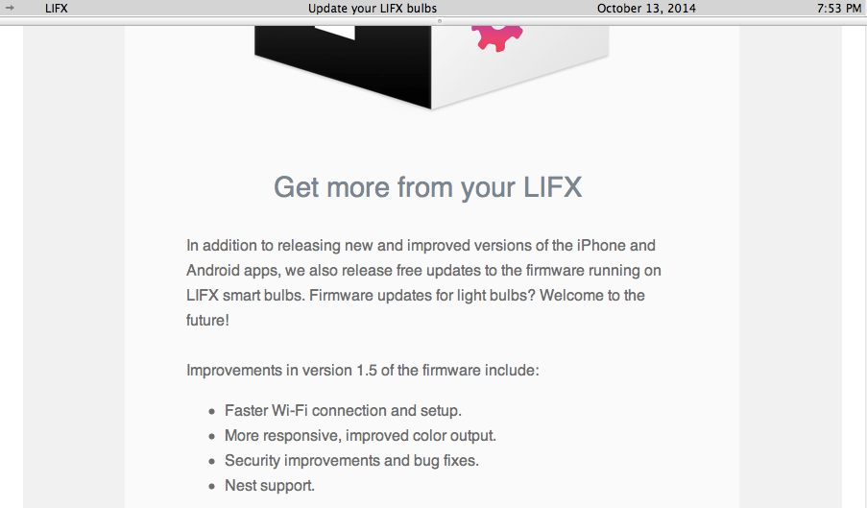
Lightbulb Does Firmware Upgrades
US San Francisco Bay Area Chapter

Slide 11



How Detect Anomolous Behavior ??

Slide 12
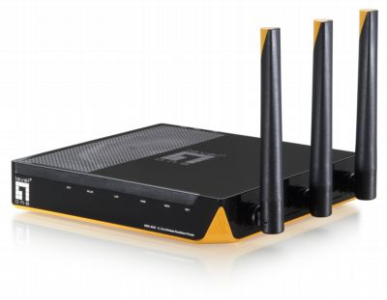
Role of DNS
Humans think in names
Machines think in numbers
Most Internet Protocol communications utilizes the DNS
www.netflix.com
IP address to get to www.netflix.com
US San Francisco Bay Area Chapter

Slide 13

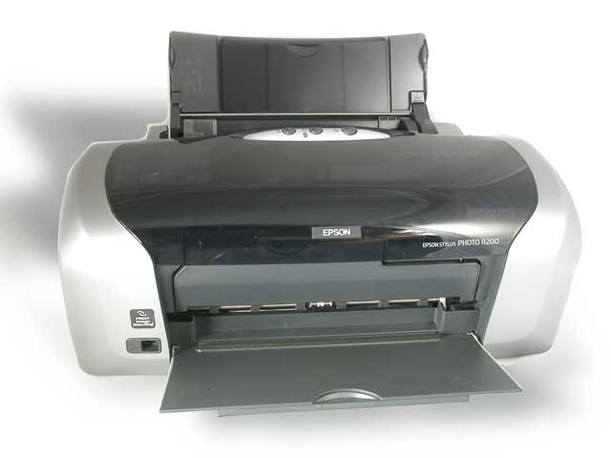
Recursive DNS Server Configurations
ISP
DNS Server is:
203.0.113.231
2001:DB8::231
Service provider automatically configures DNS Servers using automated mechanisms
OR
Service provider provides you with DNS Server IP addresses that get statically configured
Home router automatically
configures DNS Servers
over wireless network
DNS Server is:
203.0.113.231
2001:DB8::231
Home Router
WAN: 204.0.113.66
2001:DB8::66
LAN: 192.168.1.1
2001:DB8:8888::1
Computer
192.168.1.101
DNS Server is:
203.0.113.231
2001:DB8::231
DNS Server is:
203.0.113.231
2001:DB8::231
Home router automatically
configures DNS Servers over wired network
Smartphone
192.168.1.102
US San Francisco Bay Area Chapter

Slide 14
What is Passive DNS
Passive DNS replication is a technology invented in 2004 by Florian Weimer
  Many uses!
  Malware, e-crime, legitimate Internet services all use the DNS
Inter-server DNS messages are captured by sensors and forwarded to a collection point for analysis.
After being processed, individual DNS records are stored in a database
US San Francisco Bay Area Chapter

Slide 15


Passive DNS – What Is Collected
Client 1
DNS
Resolver
Q1: what is IP address of www.nsrc.org ?
Q2: what is IP address of authoritative server for .org?
Authoritative
ROOT
R2: IP address of authoritative server for .org
Q3: what is IP address for authoritative server for .nsrc.org?
Authoritative
ORG
R3: IP address of authoritative server for nsrc.org
Q4: what is IP address for authoritative server for www.nsrc.org ?
Authoritative
NSRC
R4: IP address of authoritative server for www.nsrc.org
R1: IP address of www.nsrc.org
Client 2
Q2, R2, Q3, R3, Q4, R4
Collector
Q5: what is IP address of www.nsrc.org ?
R5: IP address of www.nsrc.org
Passive DNS Sensor

Slide 16
Spoof Detection for Trust in Database
Merge query and response
Validate these fields
  Initiator IP address
  Initiator port
  Target IP address
  Target port
  Internet protocol
  DNS ID
  Query name
  Query type
  Query class
US San Francisco Bay Area Chapter

Slide 17
Bailiwick Checking
“For each record name, is the response IP address a nameserver for the zone that contains or can contain this name?”
Example: Example: root nameservers can assert knowledge about any name!
Example: Verisign’s gtld servers can assert knowledge about any domain name ending in .com or .net.
US San Francisco Bay Area Chapter

Slide 18
Some DNS Statistics
278
Million
Current
Domain Names
Questions That Can Be Answered
Using Passive DNS
Where did this domain name point to in the past?
What domain names are hosted by a given nameserver?
What domain names point into a given IP network?
What subdomains exist below a certain domain name?
What new names are hosted in ccTLDs?
100+
Million
ccTLD
Domains
10+
Billion
Current Hostnames
US San Francisco Bay Area Chapter

Slide 19
DNSDB Searches
Record Types
ANY-DNSSEC
A
AAAA
NS
CNAME
DNAME
PTR
MX
SRV
TXT
DS
DLV
RRSIG
NSEC
DNSKEY
NSEC3
US San Francisco Bay Area Chapter

Slide 20
IPv6 Reserved Addresses (RFC 6890)
Description | Network
unspecified | :: /128
loopback | ::1 /128
IPv4-IPv6 Translation address | 64::ff9b::/96
IPv4-compatible IPv6 address | ::/96
IPv4-mapped IPv6 address | ::ffff:0:0/96
discard-only prefix | 100::/64
TEREDO | 2001::/32
benchmarking | 2001:2::/48
ORCHID | 2001:10::/28
6to4 | 2002::/16
reserved | ::/8
unique-local address | fc00::/7
multicast address | ff00::/8
documentation addresses | 2001:db8::/32

Slide 21
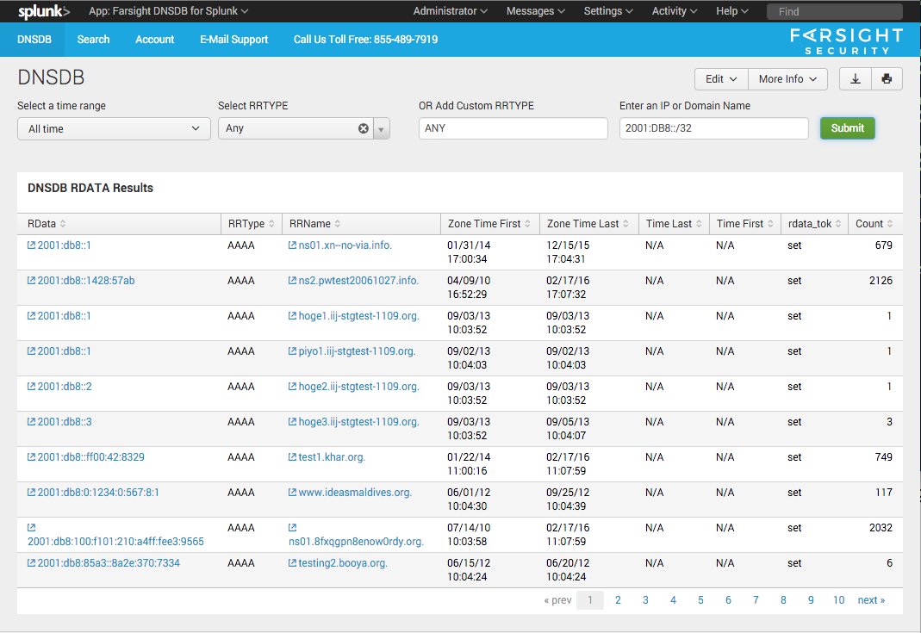
Rdata for 2001:DB8::/32 ?!?

Slide 22
DNS Changes Channel
Tracks Newly Observed Resource Record sets (RRsets)
DNS Review
  A "resource record" is a single DNS record, such as (but not limited to) a DNS "A" record mapping a fully-qualified domain name to an IPv4 address.
  A "resource record set" consist of "all the records of a given type for a given domain."
New entry gets written into DNS Changes Channel when:
  A new rrname ("FQDN") entry is written to the Newly Observed Fully Qualified Domain Names Channel, OR
  The resource records returned in response to a query differ from the resource records previously returned for that query
US San Francisco Bay Area Chapter

Slide 23
DNS Changes Sample Observations
Example 1:
Example 2:
domain: ns1p.net.
time_seen: 2016-02-18 01:35:20
rrname: syix3schsv.r.ns1p.net.
rrclass: IN
rrtype: A
rdata: 104.131.148.46
new_domain: false
new_rrname: true
new_rrtype: true
new_rr: true
new_rrset: true
domain: dotnxdomain.net.
time_seen: 2016-02-18 01:27:22
rrname: 06u-u64da9ece-s1455758842-i5125.am.dotnxdomain.net.
rrclass: IN
rrtype: AAAA
rdata: 2600:3c00::f03c:91ff:fe98:16c8
new_domain: false
new_rrname: false
new_rrtype: true
new_rr: true
new_rrset: true
US San Francisco Bay Area Chapter

Slide 24
Fields in the Sample Record
new_domain: The base domain has never been seen before
new_rrname: The FQDN has never been seen before
new_rrtype: This is a new resource record type for this FQDN
new_rr: This exact resource record has never been seen before
new_rrset: This exact resource record set has never been seen before.
Notes
  If new_domain is true, {new_rrname, new_rrtype, new_rr, new_rrset} will all also be true
  If new_rrname is true, {new_rrtype, new_rr, new_rrset} will also be true
  If new_rrtype is true, {new_rr, new_rrset} will also be true
  New_rrset will ALWAYS be true for data shown in the DNS Changes channel
  Just interested in new_domain's? Look at Newly Observed Domains
  Just interested in new_rrname's? Look at Newly Observed Hostnames

Slide 25
Newly Observed Domain Names
Most new domains (<24 hours) are nefarious
60% of the SPAM we studied used a header or envelope domain name less than 24 hours old
Most new domains don’t have a reputation yet
NOD as Streams
  Newly active vs newly observed
NOD as Feeds
  RPZ (DNS Firewall)
  RHSBL (for Spam Assassin)
Various intervals available
  5m, 10m, 30m, 1hr, 6hr, 12hr, 24hr
US San Francisco Bay Area Chapter

Slide 26
Detecting Phishing Scams
Most genuine financial institution-related domains are quite popular and long-established
Newly Observed Domains and Newly Observed Hostnames are normally worthy of careful scrutiny, because often they may in fact be fraudulent
$ nmsgtool -C ch213 -o - | grep -f phishing-strings.txt | grep -v -f whitelist.txt
The phishing-strings.txt file might contain frequently phished terms, such as: account, login, patch, update, etc
The whitelist.txt file might contain strings matching domains we believe to be unlikely to be associated with phishing, such as: .akadns.net., .edgekey.net., .fbcdn.net., etc
US San Francisco Bay Area Chapter

Slide 27
Further Investigation…
Understand where and how DNS is utilized for IoT communications
Test dual-stack and transition technology behavior to know when DNS replies utilize A and/or AAAA records
Correlate domains seen in IPv4 and in IPv6
Investigate domains seen separately from IPv4 vs IPv6 address
Passive DNS can be used to correlate
IPv4 and IPv6 related information
US San Francisco Bay Area Chapter

Slide 28

Concluding Thoughts
We all have a role to play to improve on security in this world of continuous and chaotic connectivity
Basic security and privacy relies on transparency of information
Software bugs, configuration mishaps and protocol errors are part of human existence
DNS is almost ubiquitously utilized and can be utilized to detect anomolous behavior
US San Francisco Bay Area Chapter

