Slide 1
ISOC
Internet of Things
Vint Cerf – February 18, 2016

Slide 2
The Internet of Things is already amongst us
The living room of the future
Notes:
This is a picture our colleagues at Nest came up with when their CEO Tony Fadell asked them to envision the living room of the future.
Internet of Things technology will have a profound impact on our lives - but it will not promote more screens more keyboards everywhere - technology will fade in the back and support us in our private and professional lives in many subtle and effective ways.

Slide 3
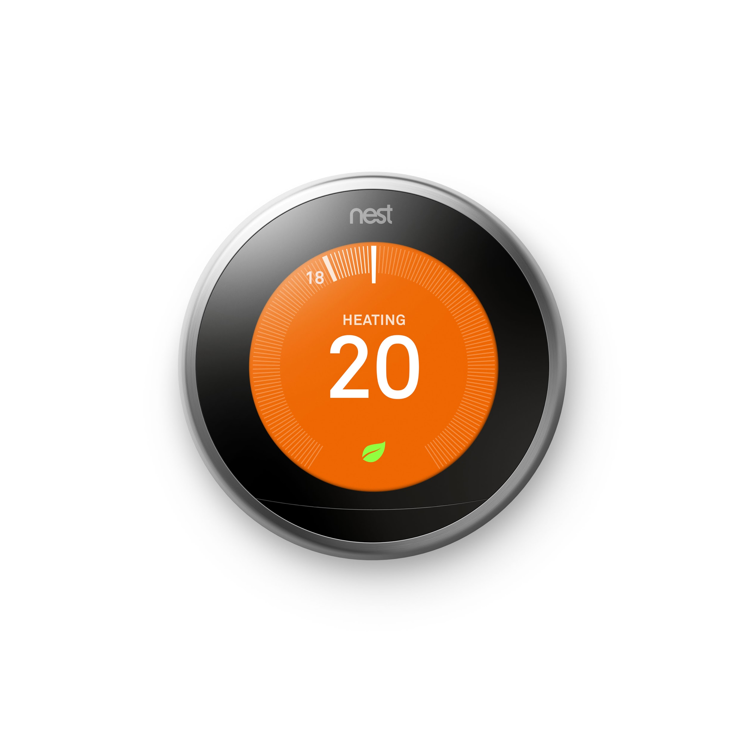
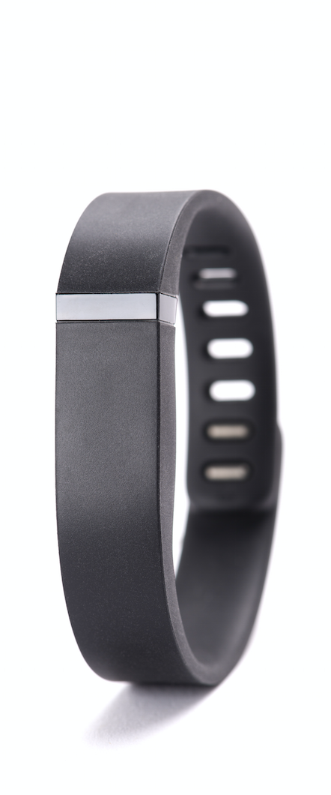
The Internet of Things is here and it touches and helps us all in different ways
The Internet of Things is already amongst us
me
my home
my community
my country
my planet
Fitbit and quantifiable health
Nest and home devices
MIT SENSEable City Lab - Copenhagen Wheel Project
Sigfox - global cellular connectivity for IoT
Aclima - Air quality monitoring
Notes:
Links: MIT SENSEable City Lab & Copenhagen Wheel Project

Slide 4
The impact of IoT from an individual to the planet...
civics
health
education
science
entertainment
Government open data
data.gov.uk
Smart Contact Lenses
Google
Connected edu platforms
SAM Labs
Scientific data sharing
CERN Higgs Candidates
Mixed reality
Magic Leap
Notes:
kickstarter: SAM: The Ultimate Internet Connected Electronics Kit
government open data: https://data.gov.uk/
CERN data sharing: http://home.cern/
Magic Leap: http://www.magicleap.com/

Slide 5
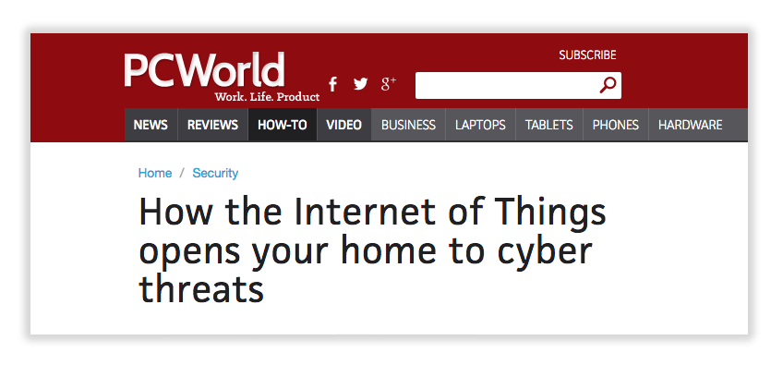
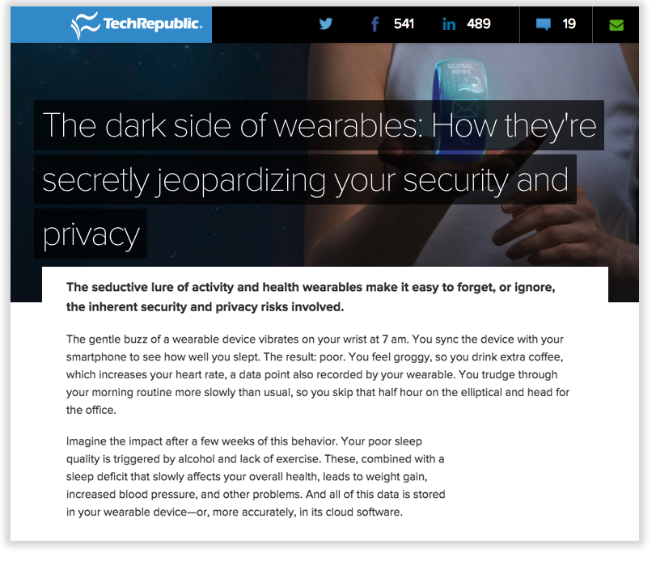
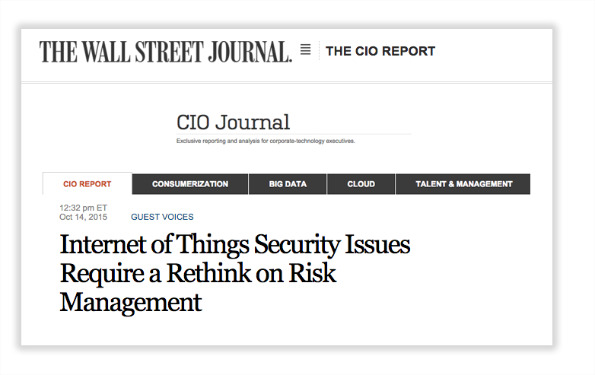
...it evokes complexity and fears over privacy and security risks
... it evokes complexity and fears over privacy and security risks

Slide 6
… how can we change user experiences to make the underlying benefits clear?
... how can we change user experiences to make the underlying benefits clear
IoT is only a bunch of connected gadgets
‘It’s not secure’
‘It’s just a gimmick, it won’t last’
‘It’s complicated’
‘I have no idea of what I’m getting myself into’
‘It’s a configuration nightmare”
IoT objects are embedded in the fabric of life
‘I’m in the center of my IOT ecosystem
and I’m in control of my data and its privacy”
‘It’s useful on many levels, I can see it’s here to stay and I’m happy about that’
‘It’s easy and built to make complex things
become easier. ‘
‘I understand what I’m doing and
the trade-offs I’m assuming.‘
"it was so easy, most devices configured themselves"

Slide 7
Re-imagine objects with the power of the net
Re-imagine statics object with the power of the web
Understanding the implications of what happens when an ‘ordinary’ object is connected to the net
+
+
=
Washing Machine
Single purposed
Little customization
Rudimentary notification system
Not aware of its energy consumption
Connectivity
New features
New services
New business models
Net
Context
Learning
Access to services and API’s
Access to other devices
Washing Machine
Adaptive
Efficient
Optimized
Personalized
web

Slide 8
2) Foster ensembles of objects & services
Smartphone
Customization
Learns what’s the best cycle to wash by sensing clothes in the drum
Knowledge
Graph
Efficiency and safety checks with other washing machines
Activates washing at most energy efficient time
Washing Machine
Smart energy meter
Washing Machine
Order product if running out based on tracked usage
Matches user arrival times with energy efficiency so clothes are ready when user is home
Shopping
Platform
User’s Calendar

Slide 9
3) Find the right relevant objects and connections
The Internet created the information graph -> that changed how we produce, access, share and generate knowledge
Total access and ubiquity of content
Social media created the social graph -> that changed how we establish and foster relationship with others
Enabling power to the crowd
The Internet Of Things creates the physical graph -> that changes how we interact with objects and environments
Adaptive, self regulating environments that understand context and adjust accordingly

Slide 10
Three fundamental pillars
Data, access control and identity management will be fundamental to our IOT systems regardless of hardware or software producer.
Systems, protocols and IoT schema are based on open standards, that will enable interoperability as well as modularity.
New human-device interaction paradigms and techniques will need to be developed and refined as keyboards will be used far less.
1
Systems & protocols
2
3
Security &
Privacy
UX and HCI
Notes:
utility

Slide 11
1) Data & Identity Management
Data & Identity Management
A user controlled system with management controls will elicit greater trust and adequate privacy while security and safety can be handled mostly by service provider.
Device hardware and software consider safety first and and auto update by manufacturer
I know my data is secure.
I have control over my data digital identity and data per sensor, per account, per product, per home
I know my devices will ask before sharing any data with other devices.
Notes:
User Controlled System
Giving users clear and easy data management controls will elicit greater trust and confidence

Slide 12
2) Openness & Interoperability
Walled Garden Approach
Interoperable, open IoT
Toaster
Washing Machine
Toaster
Toaster
Washing Machine
Umbrella
Washing Machine
Umbrella
Common IoT protocols
Protocol 1
Protocol 2
Protocol 3
Smartphone
Thermostat
Smartphone
Solar panel
Thermostat
Solar panel
Notes:
Elaborate on the failures of AOL or CompuServes closed gardens and point to the success of open ISPs.
We are not dogmatic but the innovation success of the Internet is based on the leveled playing field created by open standards and interoperability
A successful IoT ecosystem will allow startups, established SMBs and big companies to plug-in and play a role in building viable businesses.
Importantly for the IoT to become a mainstream success the IKEA’s, the Holiday-Inn’s, the Walt Disney’s and all kinds of SMBs must join the party and create connected hardware and services.
There are examples of mixed strategies e.g. Microsoft embraced some open aspects of the web and made some money despite also having a closed source OS?

Slide 13
Examples of Protocol Diversity
Smart Grid Interoperability Panel (SGIP)
Internet Protocol Smart Objects (IPSO)
AllJoyn (Allseen Alliance)
Homenet (IETF WG)
X10
NEST Thread/Weave
Constrained Application Protocol (CoAP)
Message Queue Telemetry Transport (MQTT)
IPv6 (over everything)
IEEE 802.11 (WiFi)
IEEE 802.15.4 & 6LoWPAN
ZigBee
Google Brillo/Weave
BlueTooth and BlueTooth Low Energy (BLE)
eXtensible Messaging and Presence Protocol (XMPP)
ISA110.11a, WirelessHART, MiWi

Slide 14
3) New paradigms for user interface and interaction design
App trap
User in one mode
App
Natural interfaces
voice, gestural, touch, etc
User
Smartphone
Thermostat
User
Keyboard
Washing Machine
Solar panel
Washing Machine
Thermostat
Umbrella
Toaster
Context
Notes:
App Trap
Move away from the “app trap” (one app to control one device) and decentralize the reliance on smartphones as controller to single objects or systems
User in one mode
Users interact with multiple devices using consistent single touchpoints voice, gestural and touch interfaces for devices that are context aware

Slide 15
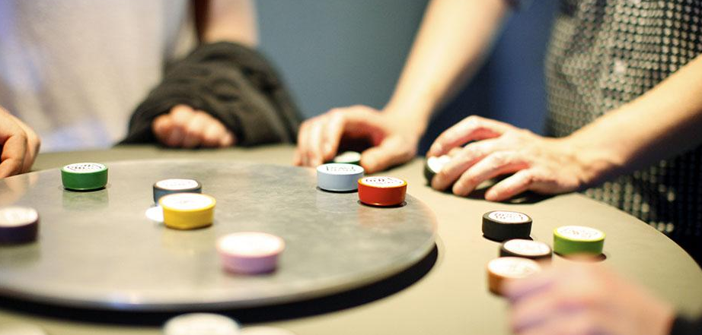
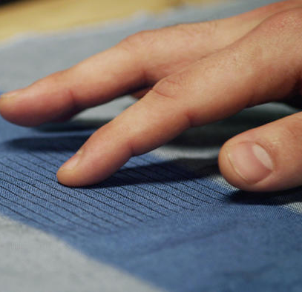
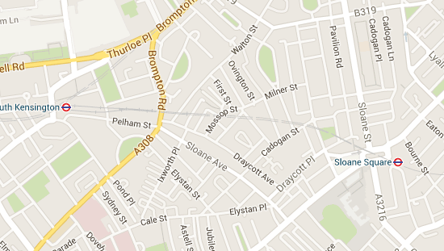
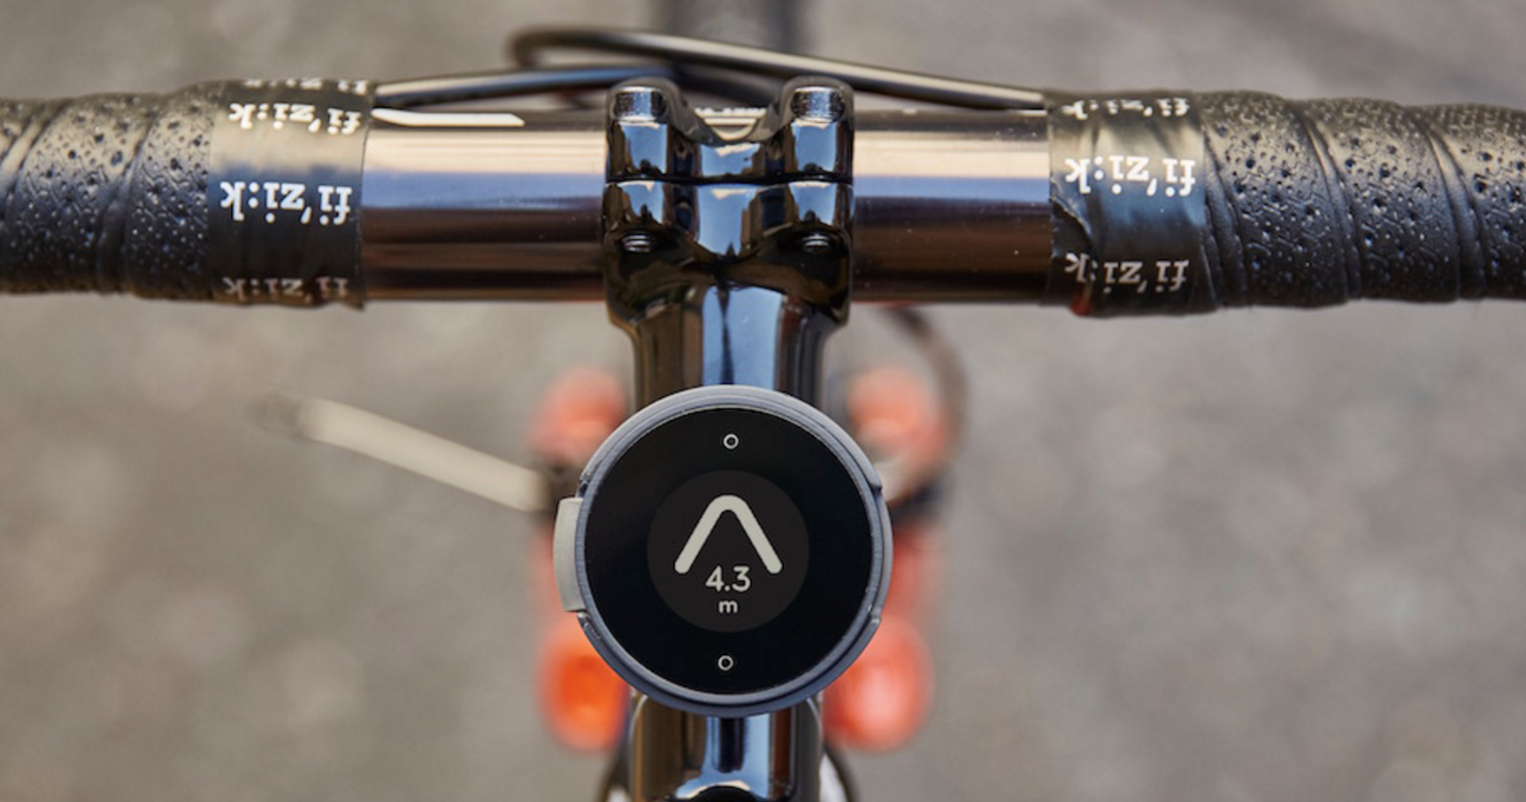
3) Reimagining interaction with ‘things’ beyond traditional interfaces
in summary, start formulating some principles for our point of view...
Music player reimagined as tactile experience
Dial Player, RCA
Mouse & keyboard reimagined as interactive textile
Project Jacquard from Google ATAP
Traditional maps reimagined as smart navigation for bicycles
BeeLine

Slide 16
IoT Hardware
Network of electronic gadgets, software and sensors -> enables these objects to collect and exchange data
IoT Software
Collection of fluid relationships -> between people, objects and spaces
Reference: Usman Haque
A perspective we like...
Notes:
Reference - Usman Haque
Essay: http://www.haque.co.uk/papers/hardsp-softsp-open-so-arch.PDF

Slide 17
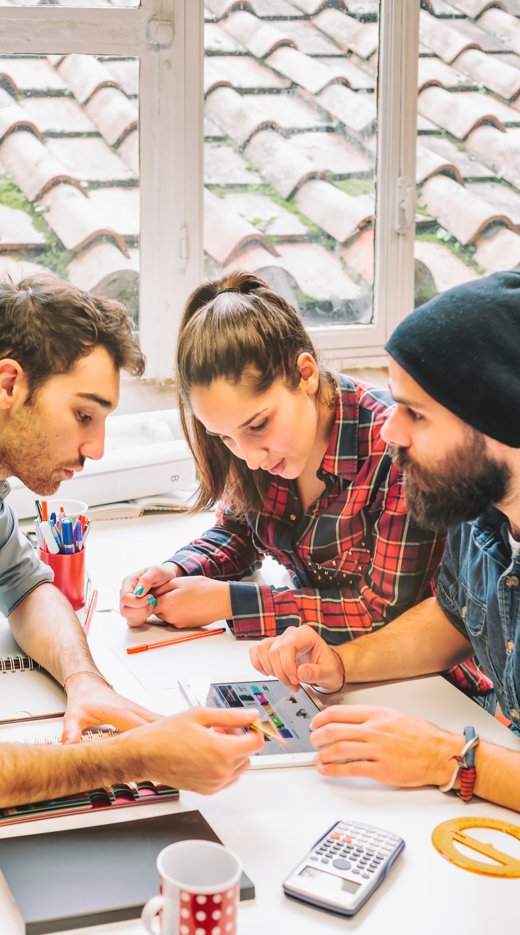
Internet of Things Living Lab: A modular, open IoT-in-box Ecosystem
The Internet of Things is already amongst us
Developed by researchers, entrepreneurs,
makers and companies
With potential to scale to smart cities
Promote interoperability and stress testing in the wild
Testbed for prototyping & evaluating ideas.
Share, build discover apps to enhance campus life
Notes:
Living Lab stack = LAMP for IOT (Linux, Apache, MySQL, PHP --- LAMP was *the* technology stack that enabled everybody to develop websites and was a big part why the WWW took off in the 90ies.)

Slide 18
Let’s expand the success story of the Internet in terms of permissionless innovation and a level playing field for all participating innovators.
Let’s promote an interoperable ecosystem based on open standards.
Let’s make identity, access control and data management an essential (new) part of the technological architecture at the start of the IoT evolution.
Call to action
1
2
3

